Slide 1


Credit Card Fraud Detection
Using the Machine Learning Classification Algorithms to detect Credit Card Fraudulent Activities
Submitted By : Simran Soni

Slide 2

Table of Contents
Abstract
Introduction
Problem Statement
Scope of the Project
Difficulties of detection
About the Dataset
Exploratory Data Analysis
Data Preparation
Machine Learning Algorithms
Base Model
Undersampling Models
Oversampling Models
Best Model
Conclusion and Future Scope

Slide 3
Abstract
It is important that credit card companies are able to recognize fraudulent credit card transaction so that customers are not charge for items that they did not purchase.
Fraud detection is a topic which is applicable to many industries including banking and financial sectors, insurances, government agencies, and more.
In the banking industry credit card fraud detection using machine learning is not only a trend button necessity for them to put proactive monitoring and fraud prevention mechanism in place.
Machine learning is helping these institutions to reduce time consuming manual reviews costly charged bags and fees as well as denials of legitimate transactions.
In this project we will detect road and credit card transactions with the help of machine learning models.
We will analyse customer level data that has been collected and analysed during a research conducted by the Machine Learning Group – ULB at Brussels, Belgium

Slide 4
Introduction
Credit Card Fraud
Illegal use of credit card or its information without the knowledge of the owner is referred to as credit card fraud. Credit Card fraud could happen by physical theft of card/details or virtually via imposters/hackers.
As we are moving towards the digital world — cybersecurity is becoming a crucial part of our life. When we talk about security in digital life then the main challenge is to find the abnormal activity.
Today, we have many machine learning algorithms that can help us classify abnormal transactions. The only requirement is the past data and the suitable algorithm that can fit our data in a better form.
Credit Card Fraud Detection is :
One of the most explored domains of fraud detection.
Occurences are rare, nonetheless involving good amount of loss.
It is an active research topic , unfortunately with very few data available.

Slide 5
Problem Statement
Credit Card stands as major problem for world wide financial institutions.
Billions of dollars of loss are called every year by fraudulent credit card transactions.
The design of efficient fraud detection algorithms is key for reducing these losses.
The main challenges in credit card fraud detection are:
Huge size of data : Millions of transactions are processed every day
Imbalanced Dataset : More than 99% of transactions are Legitimate
Adaptive Techniques : Fraudsters change style to bluff detection system
Availability of Data : Banks rarely reveal customer information (Privacy)

Slide 6
Scope of Project
Detect the fraudulent transactions
Minimization of credit card fraud
Analysis of Multiple Machine Learning Algorithms
Better Performance and Acccuracy

Slide 7
Difficulties of Detection
There aren’t lot of Credit Card Fraud data available publicly
Imbalanced Data
Different misclassification importance
Overlapping Data
Lack of Adaptability

Slide 8
About the Dataset
The dataset was obtained from Kaggle at: www.kaggle.com/datasets/mlg-ulb/creditcardfraud
This Dataset presents transactions that have occurred in two days.
The Dataset is highly unbalanced where we have 492 frauds out of 284,807 transactions.
Due to confidentiality issues, original features were not provided.
The features V1, V2, … V28 are the principal components obtained with PCA.
The only 3 Features known to us are:
1. Amount
2. Time
3. Output -> Class [ 0 for a normal transaction and 1 for a fraudulent transaction]

Slide 9
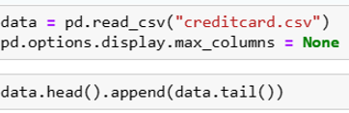

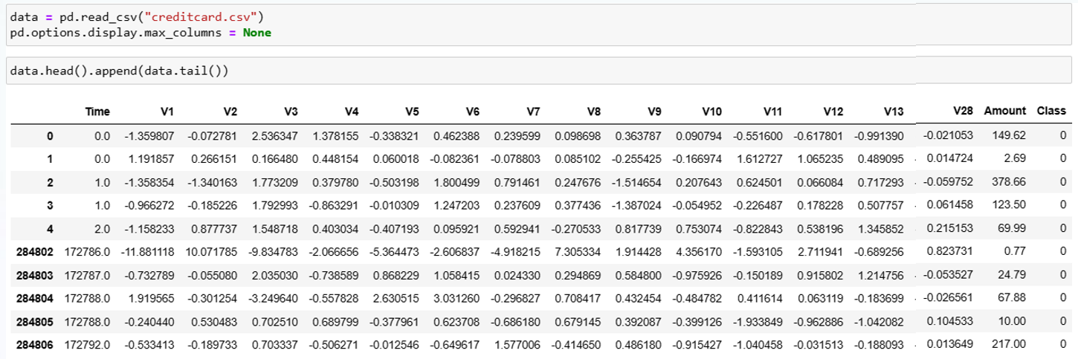
Getting an overview of the data
Using the Pandas Module to read the data with the read.csv(….) function
There are ~ 284,807 rows & 30 features + 1 Class.
Only Time & Amount are actual variables , while others are Principal Components.
All variables are numerical except Class.

Slide 10
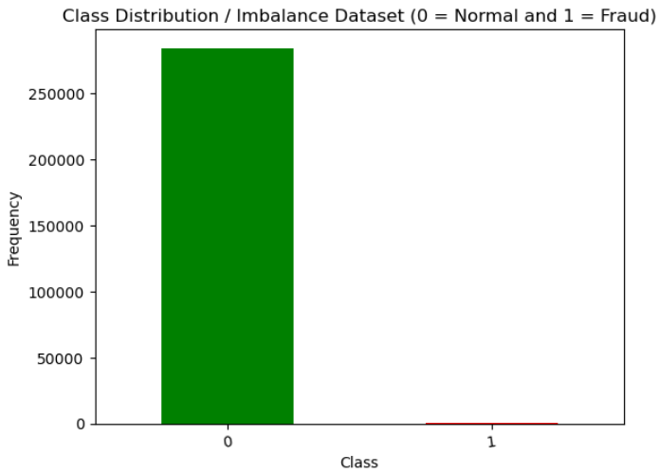
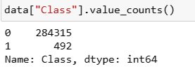

Exploratory Data Analysis (EDA)
Clearly there is an imbalance in the data with only 0.17% of the total cases are fraudulent.

Slide 11
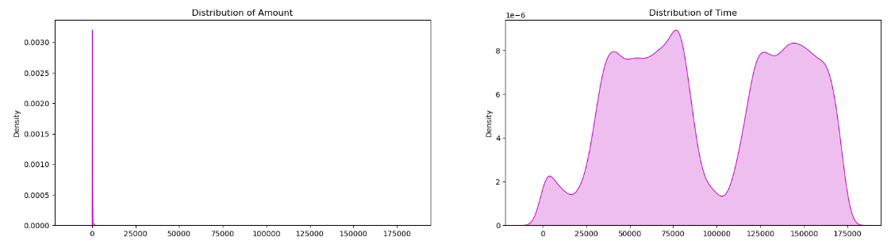
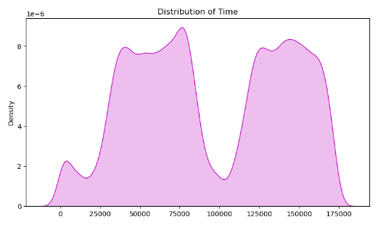
Exploratory Data Analysis (Con..)
From the distribution of the two named features in the dataset we can conclude following:
For Time, it is clear that there were certain duration in the day when most of the transactions took place.
The transaction Amount is showing skewed distribution as most of the observations lies in the top 10 percentile. Max value is 25,000$. The transaction time does not have high significance, as due to night time, there might be less no. of transactions.

Slide 12
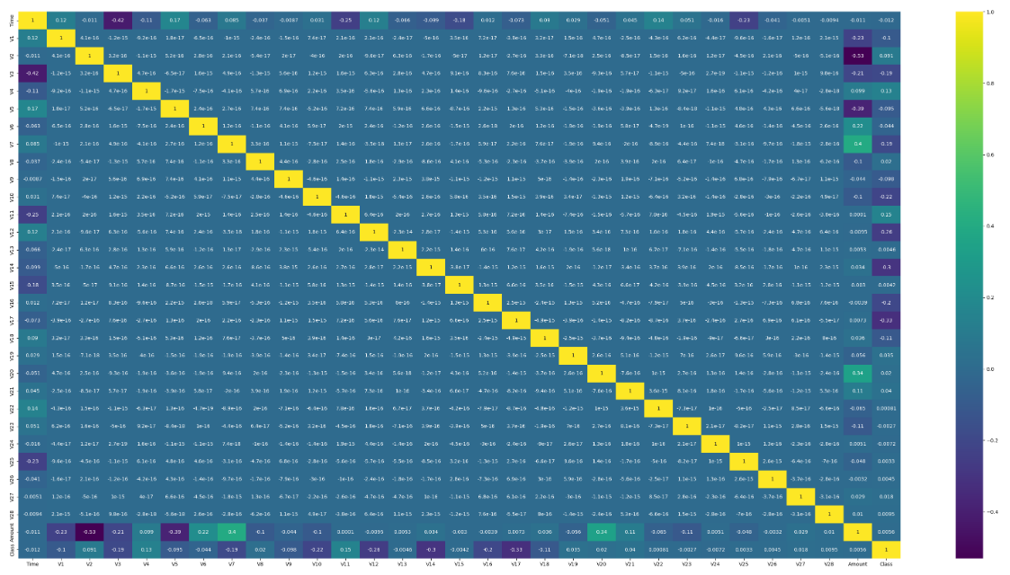
Exploratory Data Analysis (Con..)
From the below Correlation Matrix, we can conclude how all the features are with the target variable that is “Class”.

Slide 13
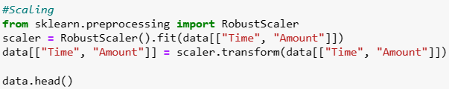

Data Preparation
Data Preparation includes the following steps:
Identifying the Null values
Scaling
Outlier Detection & Removal
Since the features are created using PCA, so the feature selection is not necessary as the number of features are small as well.
In next step , the treatment of Missing values is conducted & the result was shown as null, hence no missing values were found in the dataframe.
Next step will be standardizing Time and Amount using RobustScaler.

Slide 14
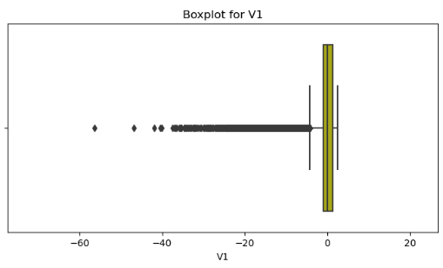
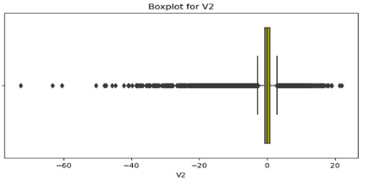
Data Preparation (Con..)
Outlier Detection & Removal :
From below visualisation of outliers & distribution of both variables, we can think of identifying observations that are extreme on either sides of the box as outliers. Further we try to calculate the IQR of all the features.
After calculating the IQR for each variable, 53376 rows from dataset were removed as Outliers.
IQR = Q3 − Q1
[Q1 – (1.5*IQR)] and [Q3 + (1.5*IQR)]

Slide 15
Machine Learning Algorithms
Machine Learning
Machine learning is the scientific study of algorithms and static models that computer system use in order to perform a specific task effectively without using the explicit instruction, relaying on patterns and interface instead.
Learning from Labelled data and applying knowledge to predict the label of new data (test data) , is known as Supervised Learning.
In this project, following Classification Algorithms are used :
Random Forest Classifier
Logistic Regression
Support Vector Classifier
Decision Tree Classifier
k-Nearest Neighbour Classifier

Slide 16
Base Model
This is the Imbalanced Class Classification Problem
First we divide the data into response and features. And also make the train-test split of the data for further modelling and validation.
As we have identified that the dataset is highly imbalanced. Fitting a model on this dataset will result in overfitting towards the majority class.
For illustration we have run one model (Random Forest) on the imbalanced data and evaluated the performance.
Validation Metrics
Validation Metrics in Classification problem are Accuracy Score, Precision Score, Recall Score & F1 Score.
Accuracy for given model is 99.9% which is very high due to imbalance data. Since more than 99% of the transactions are genuine, it is obvious to get accuracy as 99.9%. This doesn’t help to solve the problem because we want to reduce the cost of fraud transactions.

Slide 17
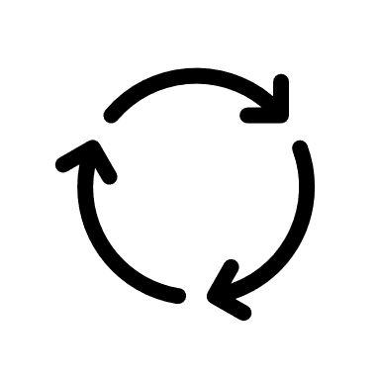
Base Model (Con..)
Validation Metrics
Precision score is also very good, but the recall score is very less.
In order to balance the data, we will use some strategies because in the imbalance data we have only 0.17% of fraud transactions .
Once the Imbalance is removed, we will use Accuracy as the validation metric on the balanced dataset.
There are 2 Methods to curb this imbalance :
1
Undersampling Method
2
Oversampling Method

Slide 18
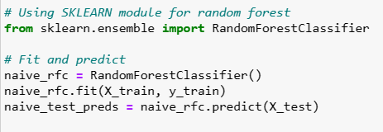
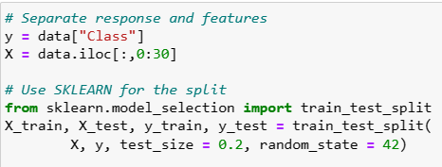
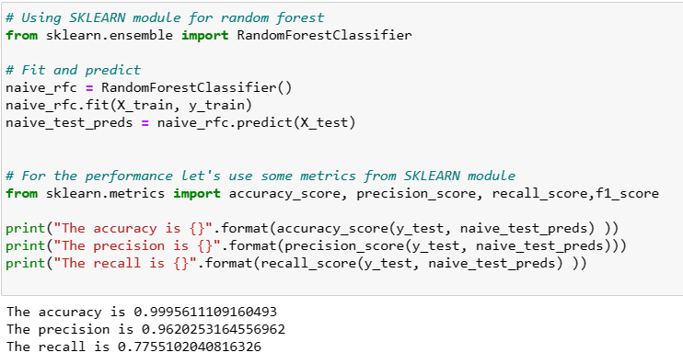
Screenshots:
First step is making the train-test split of the data for further modelling and validation.
Building Random Forest Model on the original dataset and evaluation of Performance Metrics

Slide 19
Undersampling Models
First we are going to create a cross validation framework.
We have imported StratifiedKfold , it is one of the function to do split. It will randomly pick samples in such a way that the proportion remains same.
There is one more package for imbalanced learning that is imblearn, from imblearn we will import pipeline and make pipeline.
For undersampling we will use NearMiss technique and for oversampling we will use SMOTE technique.
From sklearn , we also import classifiers like – LogisticRegression, SVC, KNeighborsClassifier, DecisionTreeClassifier & RandomForestClassifier.
The steps are as follows (The whole set-up will be structured using the imbalance-learn module):
* Use a 5-fold cross validation on the training set
* On each of the folds use undersampling
* Fit the model on the training folds and validate on the validation fold

Slide 20
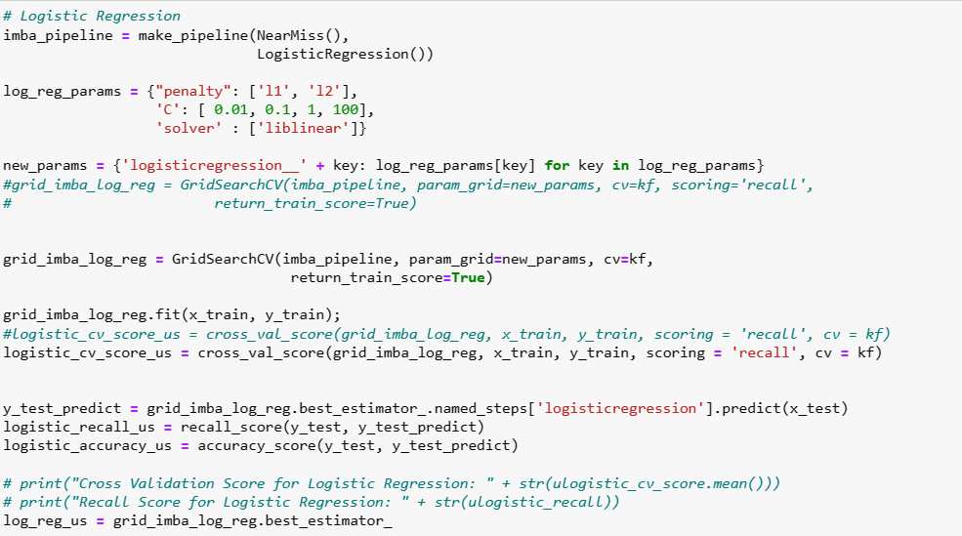
Undersampling Models (Con..)
Undersampling – Logistic Regression
First we will create a pipeline, which will reduce no. of codes. Instead of writing codes for every part, we can create function under the pipeline and it execute end to end. Imblearn pipeline will ensure that the undersampling or oversampling is done during the cross validation.and not before the cross validation.

Slide 21
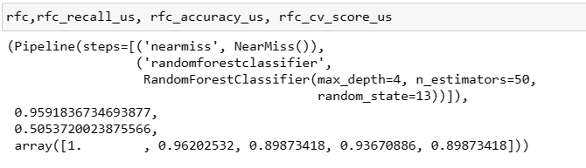
Undersampling Models (Con..)
Undersampling – Random Forest Classifier
In Random Forest, we are creating a similar pipeline like the previous model.
If we look at the validation metrics – Recall is 95%, which is high & good.
The Accuracy 50.5%, which is very low.
The CV scores lies in range of 89%-96%.
Only issue we can detect is the accuracy is very low.

Slide 22
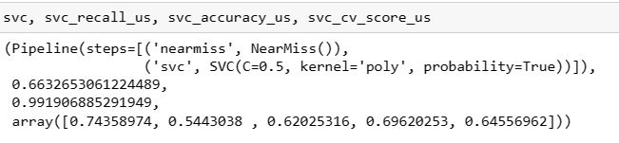
Undersampling Models (Con..)
Undersampling – Support Vector Classifier (SVC)
In Random Forest, we are creating a similar pipeline like the previous model.
If we look at the results, the Recall Score is 66%, which is even less than the basic Random Forest model. However , the accuracy is 99% as compared to Logistic & Random Forest Classifiers.
The CV scores has inconsistency , as the scores are spread over from 54% to 74% and the values significantly are very less.

Slide 23
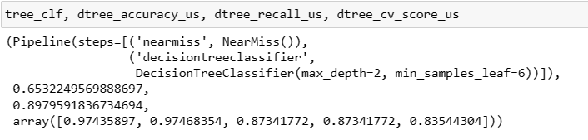
Undersampling Models (Con..)
Undersampling – Decision Tree Classifier
In Decision Tree Classifier, we have criterions like Gini & Entropy.
The Model is based on similar pipeline like the other classifier models.
The max_depth is 2 and the minimum samples leaf is 6.
The Recall score is 65% and Accuracy is 89% for the given model.

Slide 24
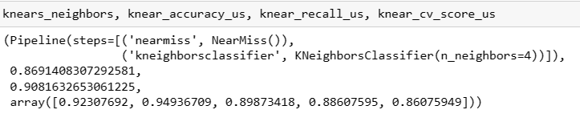
Undersampling Models (Con..)
Undersampling – k-Nearest Neighbour
If we look at the results from k-NN model, the number of neighours chosen was 4., which gave the best results.
The accuracy score is 86% & recall score is 90% , which is good.
Also, we can see that the accuracies are not spread out in the CV Scores which depicts that the model has performed consistently.

Slide 25
Oversampling Models
In oversampling technique, we will oversample the minority class and keep the majority class as it is.
SMOTE package will solve the problem of oversampling the minority class.
We will also use RandomizedSearchCV , such that it will take less time to run because it needs less time to test on the data.
We will use the same pipeline to run our codes. This time we will use SMOTE as parameter.
We will use the Oversampling Method on all the following Models :
LogisticRegression
RandomForest Classifier
Support Vector Classifier
Decision Tree Classifier
KNN Classifier

Slide 26
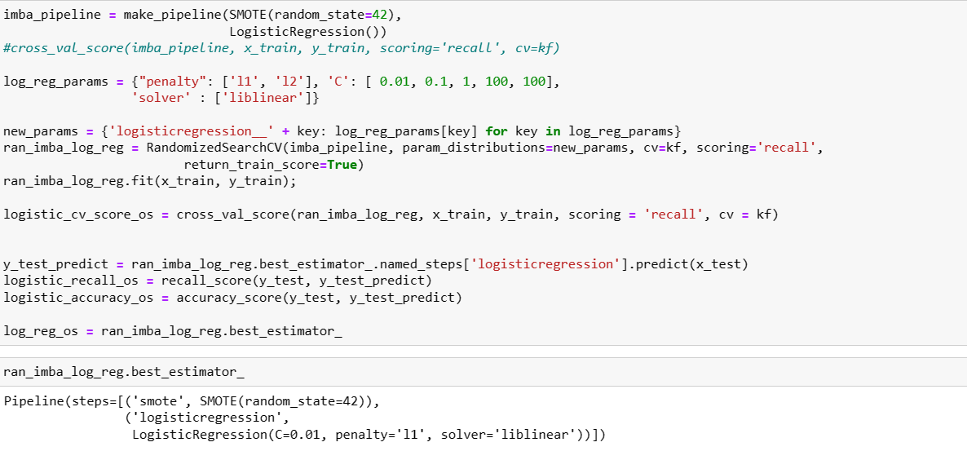
Screenshots:
OverSampling Method used on Logistic Regression

Slide 27
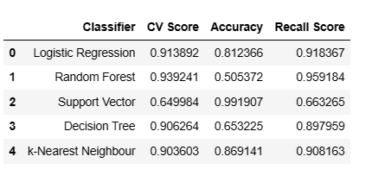
Best Model
Summarizing the Undersampling Model Performance

Slide 28
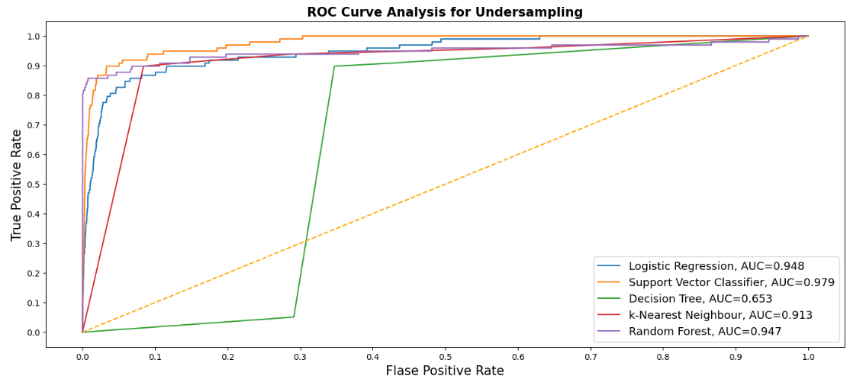
Best Model (Con..)
ROC Curve Analysis for Undersampling
The curves of different models can be compared using ROC Curve. We can also use AUC metric as summary of model. We can clearly see that 4 out of 5 classifiers have good AUC and it is more than 0.9.

Slide 29
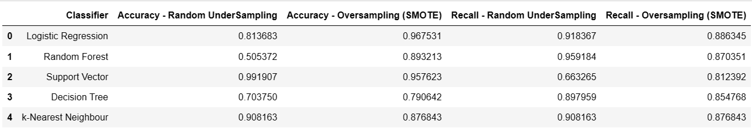
Conclusion & Future Scope
As we have discussed that we will be giving more priority to Accuracy and Recall. So, we have summarized it in a table from UnderSampling and OverSampling methods.

Slide 30
Conclusion & Future Scope
From Logistic Regression – We can clearly see that the Accuracy is 81% and it occupies the 3rd position in UnderSampling. Also, the Recall score is 91%. In terms of OverSampling , Logistic Regression has the highest Accuracy which is close to 97%.
In Random Forest , the accuracy is very low which is 50%, however the Recall is 95%. Hence, we will be discarding Random Forest as potential model.
Accuracy for Support Vector Classifier is 99% which is very good , but the recall is 66%, which is less for our main metric. Hence, we will be discarding SVC.
Decision Tree & KNN is discarded since it has low accuracy & recall scores as compared to other models.
In case of UnderSampling or OverSampling Logistic Model – We can choose Logistic UnderSampling because it takes very less time to train but in terms of Accuracy, OverSampling is giving us more reliable results.
The Accuracy & Recall Scores of Logistic Regression is high as compared to all the other models. Logistic Regression Model has shown consistent performance.
Hence, we can choose the Logistic Regression Model as the Best Model to use going forward.

